Slide 1

Becton, Dickinson & Co
Introductions
BD’s Background
Information Technology
Questions

Slide 2
Introductions and Career Paths
Elaine
Collaboration Technologies COE
2nd Year IT Leadership Program Associate
RPI, 2012, MGMT - MIS
Application Security
Information Security
Collaboration Services

Slide 3
Introductions and Career Paths
Vinny
Collaboration Technologies COE
Product Innovation - ITLP Alumni
RPI, 2010, ITWS - Finance
Business Intelligence
Product Innovation
Product Innovation
Supply Chain
Network Engineering

Slide 4
Introductions and Career Paths
Kristin
Service Planning and Management
1st Year IT Leadership Program Associate
RPI, 2013, MGMT
Learning and Training Technologies
Service Planning and Management
Collaboration Services

Slide 5
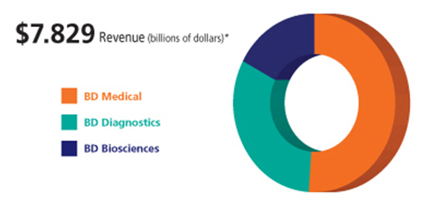
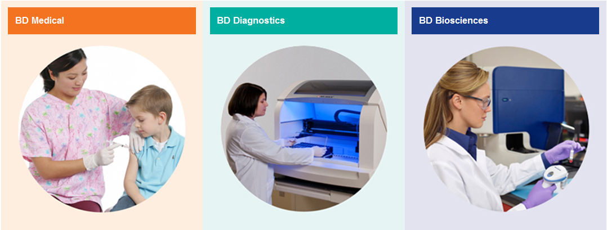






BD Overview
Notes:
BD is a leading global medical technology company that develops, manufactures and sells medical devices, instrument systems and reagents. The is dedicated to improving people's health throughout the world. BD is focused on improving drug delivery, enhancing the quality and speed of diagnosing infectious diseases and cancers, and advancing research, discovery and production of new drugs and vaccines. BD's capabilities are instrumental in combating many of the world's most pressing diseases.
Example of getting your blood taken
Medical : Blood collection
Diagnostics: Analysis of the specimen
Biosciences: Takes it a step further, cell biology
All of our businesses and employees are driven not only by the financials but by a mission to seek fulfillment through our four core values….
Core Values
We treat each other with respect
We do seek to improve
We do accept personal responsibility
We do the right thing
These values set the collaborative culture at BD and enable us to be leaders in the field of Medical Technology.

Slide 6
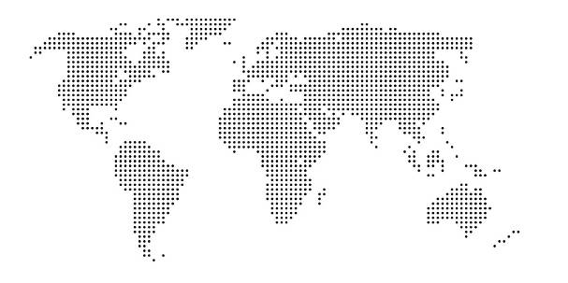
BD Locations
Japan - 1971
~600 Associates
1 Plant
Canada - 1951
~550 Associates
1 Plant
Europe - 1952
~6,000 Associates
21 Countries, 10 Plants
Asia Pacific - 1971
~4,600 Associates
16 Countries, 5 Plants
U.S.A. - 1897
~12,000 Associates
29 Plants
India - 1995
~550 Associates
Latin America - 1952
~5,200 Associates
8 Countries, 5 Plants
China - 1994
~2,200 Associates
EMA - 1994
~ 250 Associates
10 Countries
Industrialized Markets
Emerging Markets
Notes:
Founded in 1897 and headquartered in Franklin Lakes, New Jersey, BD employs approximately 29,000 associates in more than 50 countries throughout the world. The Company serves healthcare institutions, life science researchers, clinical laboratories, the pharmaceutical industry and the general public.

Slide 7
Envisioned Future
[Video Played Here]

Slide 8
Emerging Leaders
Internship
High-Impact Projects
Executive Visibility
Career Development
Philanthropy
Peer Mentorship
Externship
Explore BD
IT Leadership Presentations
A Day in the Life
Networking with BD IT
Future Internship Prospects
Notes:
Externship Overview:
What: One day event geared towards helping students understand what to expect in their early professional careers after college graduation
When: Early January during college winter breaks
Where: Franklin Lakes, NJ
Who: College Sophomores and Freshman interested in IT
Explore BD
One day visit Franklin Lakes campus
Arrive to fresh breakfast and BD Overview
Discover what BD does and its mission
The products we make, the people we serve, etc.
Tour Franklin Lakes’ campus
Open dialogue with CIO
Eat lunch in BD’s campus center
A Day in the Life
Shadow current member of the ITLP for 2 hours
A view into what early career associates actually do
Meetings, current projects, etc.
This is the students’ turn to ask questions
Anything they’re interested
And the survey says…The most fun and beneficial part of the day (80% listed as favorite)
Networking
Meet associates who are alumni of your school
Meet associates who share similar interests to you
Contacts you can reach out to for future help and advice
Career Development
Backpack to briefcase workshop
Resume and interview tips
Resume review
Great addition to resumes
Many companies look for Juniors with prior experience for internships, except it’s hard to get that experience without that first internship.
Good first step as a freshman / sophomore to show your interests and career aspirations.
Shows initiative and commitment in your professional career and helps to set yourself apart from your peers
Internship:
10 week program
High-Impact Projects
SAP experience, project management, web development
Executive Visibility
Presentation to the CEO
Career Development
Skills workshops, mentoring, teambuilding activities
Philanthropy
Volunteering/Community Service
Peer Mentorship
Access to current ITLPs for guidance and development

Slide 9
IT’s Impact at BD
IT/Business Integration
Research and Development
Validated Content Management
CAD Integration
Sales and Marketing
Customer Portals
Mobility Initiatives
Supply Chain
Order Execution
Manufacturing Automation
FUNCTIONAL
VISIONS
Finance, HR, Procurement
Product Lifecycle
Innovation Management

Slide 10

Recruiting Events at RPI
9/26
Student Union
9:00 – 5:00
9/27
Career Fair
10:00 – 3:30
9/28
Career Fair
10:00-3:30
10/01
Deadline to apply
1
2
3
4

Slide 11
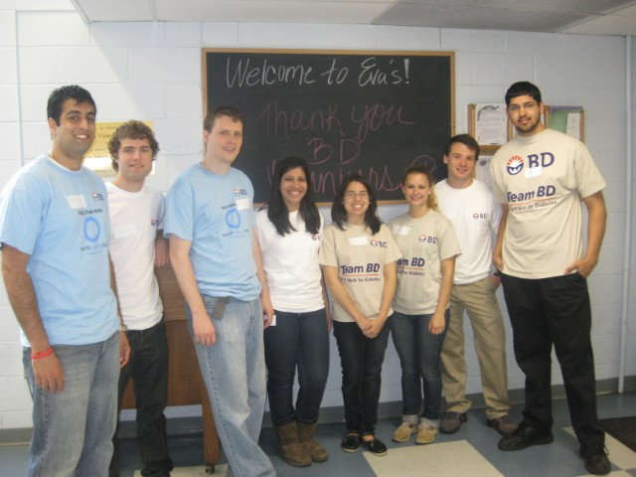
ACCOMPLISH YOUR LIFE’S WORK
AS PART OF YOUR WORK LIFE
Notes:
11
11
Our company’s position in healthcare gives us the opportunity to have impact far greater than the products we make.
“The most meaningful thing that you can do is to take your talents and your energy and find a way to accomplish a greater good. And to do that collectively as a company…that’s a privilege.” ~Gary Cohen, Executive Vice President

